Slide 1


inte GREAT ing stories

Slide 2

Proiectul Erasmus + K229 cu titlul ‘’inteGREATing stories’’, KA2 Cooperation for Innovation and Exchange of Good Practices, Key Action 229 School Exchange Partnership. Numărul de referință 2020-1-DK01-K A229-075085.
2020-2023

Slide 3

Aims of Erasmus+ projects:
Stimulating collaboration and mobility of nations;
Strengthening European dimension in education;
Gaining and exchanging the experiences and competences.

Slide 4

Strategic Partnership & Exchange Partnership projects in the field of School Education
Make it possible for schools and organizations from different participating countries to work together, to develop, share and transfer best practices and innovative approaches in the fields of education, training and youth.
Allow schools and organizations to develop and reinforce networks, increase their capacity to operate at transnational level, share and confront ideas, practices and methods.
Allow partners to work together on issues of shared interest during 1-3 years in order to produce innovative project outputs (handbooks, guidebooks, methodologies, etc.) and/or engage in exchange of good practices, new forms of cooperation with partners from different fields.

Slide 5

Objectives of the project “GREAT”:
To develop high tolerance towards diversity and to get a deep understanding of the concept of being a refugee;
To foster positive attitude towards refugees;
To develop national sense of European unity;
To empower and inspire pupils to active citizenship, fostering stronger participation of young people in democratic and civic life in Europe;
To support pupils in acquiring and developing basic skills and essential key competences that contribute to their personal development and growth as individuals.

Slide 6
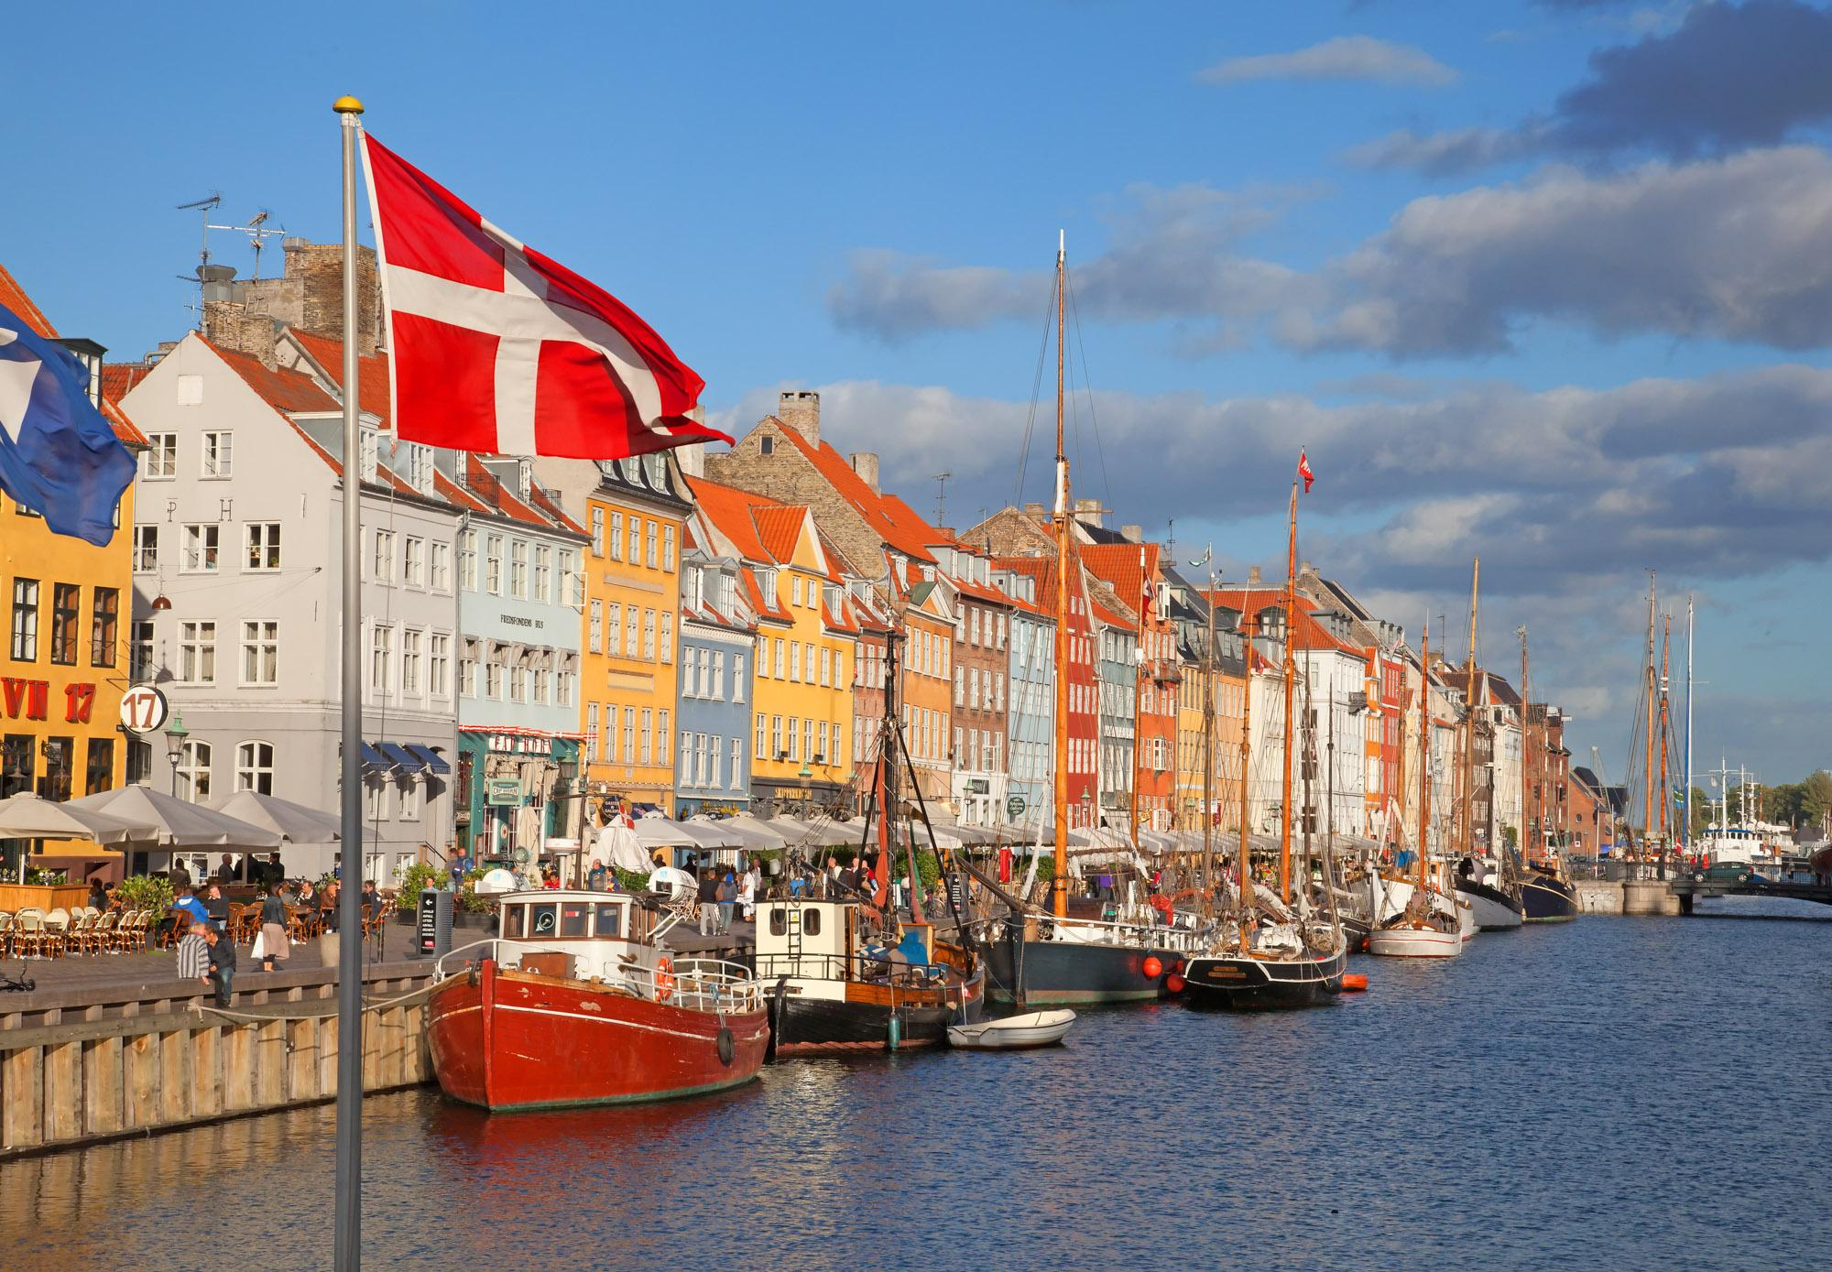
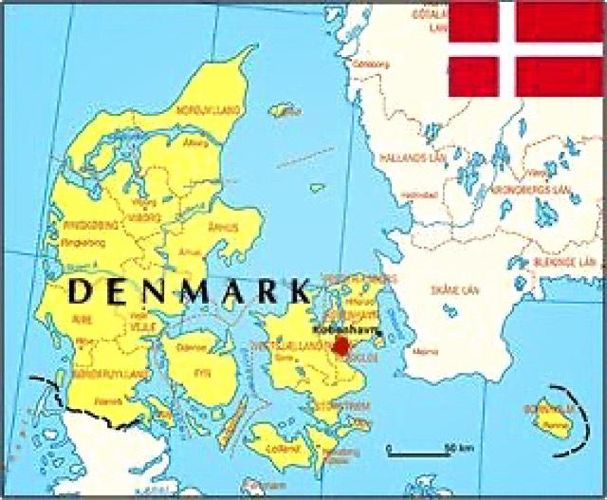
GREAT project partners:
Denmark, Køge
coordinating country
c

Slide 7
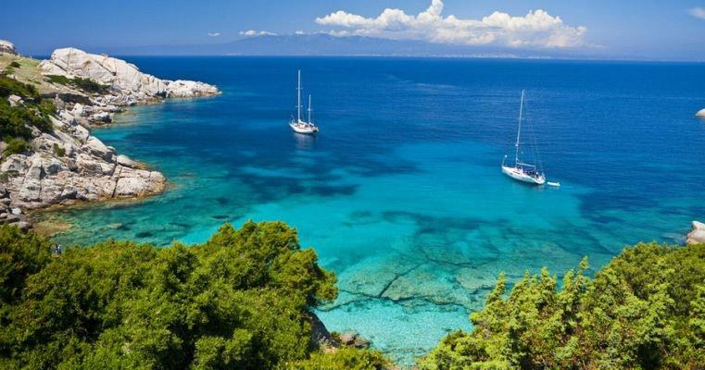
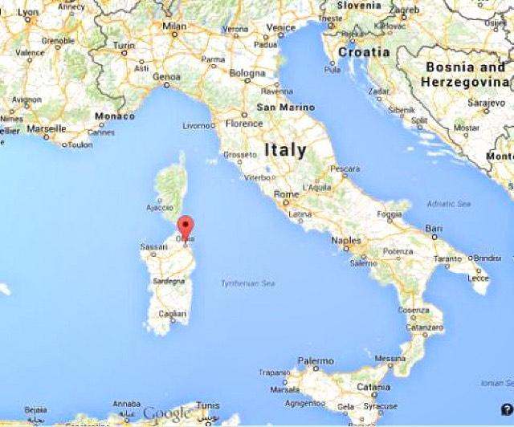

Italy, Olbia
c

Slide 8
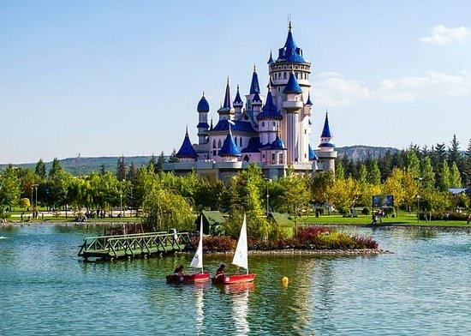
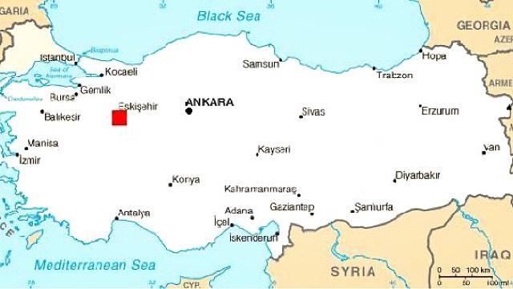

Turkey, Eskişehir

Slide 9
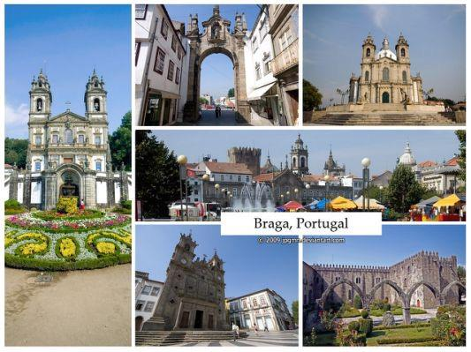

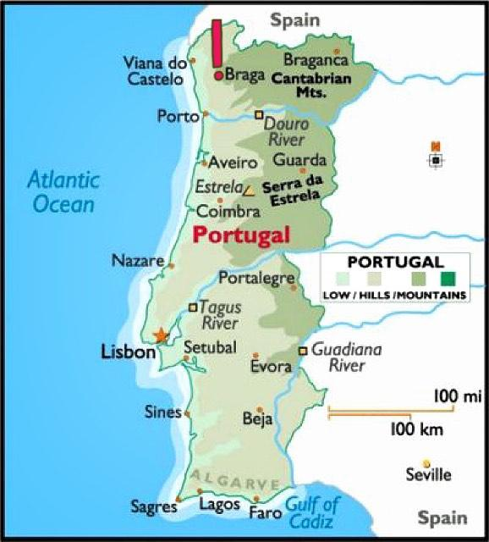
Portugal, Braga

Slide 10
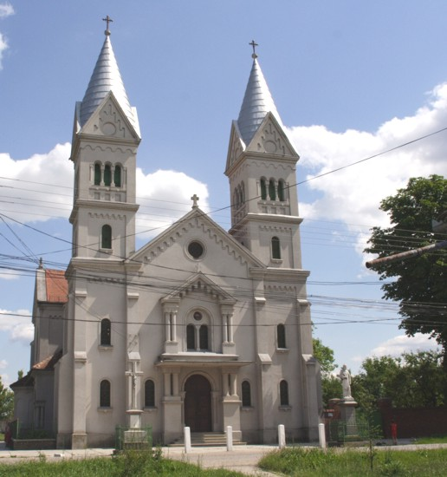

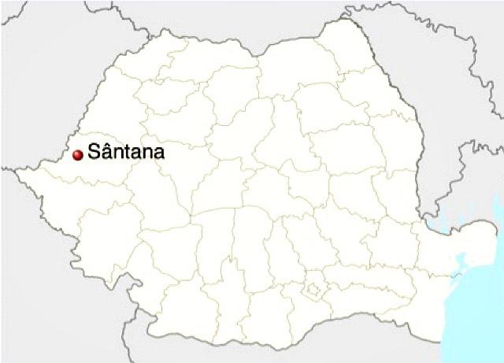
Romania, Sântana

Slide 11
Mobilități și întâlniri de lucru în toate școlile din țările partenere. România, Turcia, Italia, Danemarca și Portugalia

Slide 12
Turcia 2 profesori din fiecare țară România, Portugalia și Italia 6 profesori și 24 de elevi Danemarca 2 profesori din fiecare țară

Slide 13

Learning Teaching Training Activity C1:
Activity type: Short-term joint staff training event
Activity title: E-twinning Informative Session for Teachers
Leading organisation: ÖZEL ÇAĞDAŞ OKULLARI
Starting period: 6-10 September 2021
Duration: 5 days
Country of venue: Turkey
Activities: Informative seminar on how to use etwinning/twinspace (training on etwinning); presentation of expert on children’s literature (genre, plots, illustrations, language); seminar about a research method/academic poster.

Slide 14

Learning Teaching Training Activity C2:
Activity type: Short-term exchange of groups of pupils
Activity title: Story Writing Session for Pupils
Leading organisation: Liceul Tehnologic "Stefan Hell"
Starting period: 6-10 DECEMBER 2021
Duration: 5 days
Country of venue: Romania
Activities: Presentations of the refugee interviews’ findings; negotiation in multi national teams; peer learning-sharing ideas, knowledge & experience; writing stories.

Slide 15

Learning Teaching Training Activity C3:
Activity type: Short-term exchange of groups of pupils
Activity title: Illustration Session for Pupils
Leading organisation: Agrupamento de Escolas Alberto Sampaio
Starting period: 2-6 MAY 2022
Duration: 5 days
Country of venue: Portugal
Activities: Visit to NGO, working with refugees; pair work on producing illustrations for stories; presentations on achievements, sharing ideas, knowledge & experience; graphic design program’s introduction.

Slide 16

Learning Teaching Training Activity C4:
Activity type: Short-term exchange of groups of pupils
Activity title: Graphic and Design Session for Pupils
Leading organisation: ITCG deffenu
Starting period: 19 - 23 SEPREMBER 2022
Duration: 5 days
Country of venue: Italy
Activities: Making a graphic design of the story book, using typography, photography, and illustration(combination of stories from LTTAC2 and drawings/illustrations from LTTAC3); sharing experiences of visiting refugee NGOs at the conference; research poster discussion.

Slide 17

Learning Teaching Training Activity C5:
Activity type: Short-term joint staff training event
Activity title: Preparing the Academic Poster
Leading organisation: Køge Business College
Starting period: 8 -12 MAY 2023
Duration: 5 days
Country of venue: Denmark
Activities: discussion of data gathering procedure and analyses of academic posters’ examples - slide show presentations ; producing an academic poster; sessions on dissemination activities and sustainability of the project.

Slide 18
In school activities:
Extracurricular learning events;
Presentations of school/country/project team;
Project Corner;
Research on the situation of refugees in the country/city;
Creating of videos-reviews of 3 children’s books

Slide 19
Transnational Project Activities:
Interviews with refugees;
Writing refugee stories;
Illustrations of refugee stories;
Graphic design of the story book;
Visiting and cooperation with refugee NGOs;
Creating of the refugee story book;
Creating of the academic poster.

Slide 20
eTwinning Activities:
”Pages”of Twinspace - exchanging information about project activities, uploading photos, sharing the tasks;
Interaction in padlets, forum, networking, dialogue between pupils using twin-mail platform;
Live events on the portal;
Sharing of the minutes, photos, and decisions taken after every transnational meeting.
Sharing of the final project product - the refugee story book in Twinspace.

Slide 21
Strategic Partnership & Exchange Partnership projects in the field of School Education
. Rezultatele acestui proiect Erasmus + se împart în două categorii:
Rezultate concrete, care includ utilizarea la nivel înalt a portalului de e-Twinning, logo-ul proiectului, sloganul acestuia, pliante, blog, colțurile Erasmus+ din fiecare școală, interviuri, cartea de povești ilustrată pentru copii, poster academic, chestionare, seminarii oferite de experți, articole în presa națională și internațională, afișe etc.;
Rezultatele abstracte precum schimbarea mentalității despre refugiați, conștientizarea dificultăților cu care aceștia se confruntă, cooperarea și experiența internațională, toleranță ridicată față de diversitate.

Slide 22

Let’s make a difference together!

